Slide 1
Design Research for a Classroom of the Future with Haworth & GVSU’s Seidman College of Business
Cassandra Skinner, M.A., M.A.
June 28, 2021
Candidate Research Example

Slide 2
Agenda
Introduction
Learning Goals
Research Questions & Methods
Data Collection & Results
Professor Interviews
Student Surveys
In-Class Observations
Key Findings
Challenges & Solutions
Summary
Contact Info

Slide 3
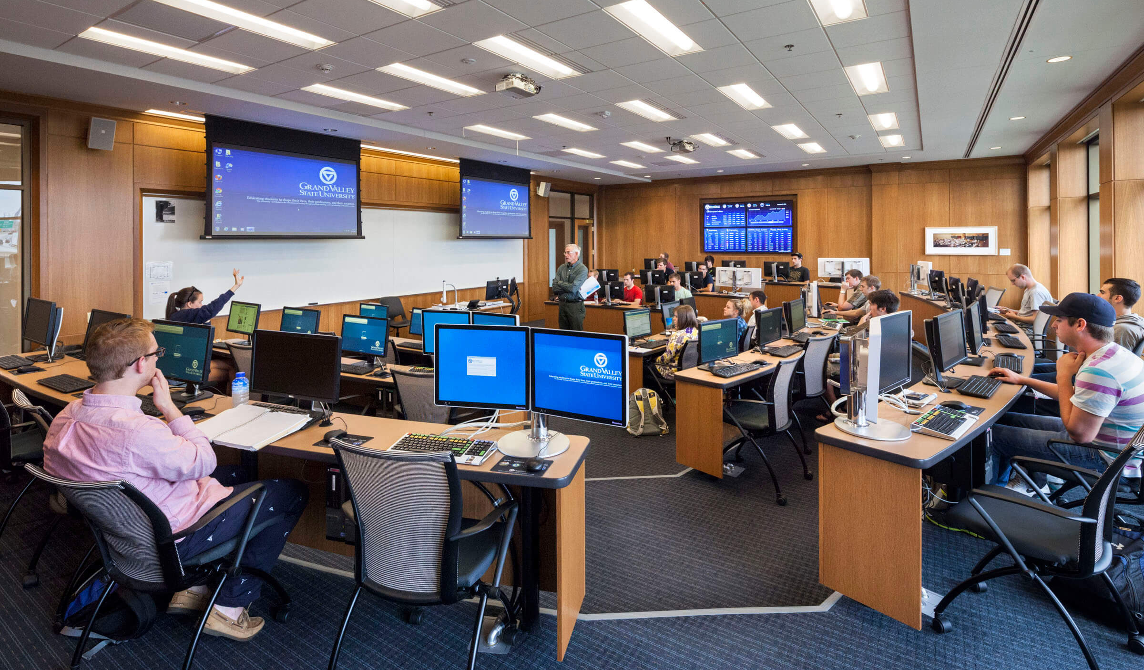
Introduction
Haworth Inc. partnered with GVSU’s Seidman College of Business to begin imagining what classrooms of the future need to look like to continue providing students with optimum value in the post-COVID-19 era, with emphasis on team-based and experiential learning. This begins with understanding values, needs which are and aren’t met, and behaviors in classrooms today. This study took place Fall 2020.
The strategic goals of the project were to not only generate insights into students’ and faculty members’ expectations for classrooms in the future, but to also build a partnership with GVSU as Haworth expanded their market share of commercial furniture within the higher education space.
Given the unique challenges faced while conducting this research during the COVID-19 pandemic, I had to be okay with the study not going to plan and think critically about how best to gather the insights we needed from students for the next round of the study - for which we ultimately decided to take a completely different, more inclusive and interactive approach.
Notes:
Why students and professors will go to classrooms instead of online learning? They can only get the team and interpersonal experiences and supports in the room.

Slide 4
Learning Goals
To understand what students and professors value about in-person and online educational experiences
To understand how professors and students want to interact with one another in classroom settings
To understand how students and professors actually use classroom spaces to interact with one another
To explore how students’ and professors’ perceptions of space might impact the way they interact within it

Slide 5
Research Questions & Methods
 | Part I | Part II | Part III
Unit of Analysis | Instructors | Students | Teams
Research Questions | What pedagogies and teaching methods do professors use and how do they use classroom spaces to support them? What works well in and what is missing from traditional classroom spaces and the Haworth spaces? | How do students perceive the spaces before and after interacting with/in them? What mediates students’ perceptions of the spaces? How might these survey results help explain what students expect vs. need out of classrooms when compared to observation and focus group data? | How do student teams actually use the Haworth spaces within the classroom? What characteristics help/hinder student team interactions for different kinds of tasks? What do student teams expect/want out of their classroom tools & experiences?
Method(s) | Interviews | Surveys | Observations & Focus Groups

Slide 6
Research Questions & Methods
 | Part I | Part II | Part III
Unit of Analysis | Instructors | Students | Teams
Research Questions | What pedagogies and teaching methods do professors use and how do they use classroom spaces to support them? What works well in and what is missing from traditional classroom spaces and the Haworth spaces? | How do students perceive the spaces before and after interacting with/in them? What mediates students’ perceptions of the spaces? How might these survey results help explain what students expect vs. need out of classrooms when compared to observation and focus group data? | How do student teams actually use the Haworth spaces within the classroom? What characteristics help/hinder student team interactions for different kinds of tasks? What do student teams expect/want out of their classroom tools & experiences?
Method(s) | Interviews | Surveys | Observations & Focus Groups
Zero Volunteers

Slide 7
Instructor Interviews
Part I

Slide 8
Instructor Interviews
Demographics
 | Pre-Semester Interviews | Post-Semester Interviews
Total Interviews (n) | 6 | 6 (one new participant)
Range of Experience | 1-35 Years | 1-35 Years
Academic or Professional Track | 2 Academics, 4 Professionals | 2 Academics, 4 Professionals
Teaching Styles | 2 Lecturers, 4 Activity-Based | 1 Lecturer, 5 Activity-Based
Teaching Areas | Marketing, Management, Communications, Sales, and Accounting | Marketing, Management, Communications, and Sales

Slide 9
Instructor Interview Findings
Themes & Insights
Professor Teaching Style | COVID | Classroom Features | Haworth Spaces | Bluescape
Heavy focus on group work “Real world” activities Higher the class level, fewer lectures “Facilitator” | “ADAPTATION” Smaller class sizes More online content delivery Slower curriculum | Flexibility (wheels) Ability to come together and break out Ability to move around room to engage with students Ability to toggle between formal and informal | Everyone dislikes the lounge spaces Bottom level fills up first Lack of surfaces is difficult Like that they’re group-oriented Dislike that they don’t feel flexible | Good data repository Hard to facilitate group work in real time Different tech backgrounds “CLUNKY”
Notes:
Thematic Approach to Analysis

Slide 10
Instructor Interviews
Potential Identified Opportunities
To-Do Type Chairs Mobile & Casual Furniture Larger individual surfaces Designs which have more obvious but changeable “front of the room”
Takeaways
Professors value interactive and team-based learning and as such want to take on facilitative roles
Professors value mobility, flexibility, and choice in classroom tools and furniture
Professors need a balance between casual, interactive classroom spaces and more formal, traditional classroom spaces for different activities
Overall, professors who lectured less had a more positive experience with the room
COVID-19 severely impacted professors’ abilities to take full advantage of the Haworth spaces
Notes:
COVID-19 might’ve had a more impactful effect on professor/student learning than the furniture/tech
Professors felt unable to use the furniture and tech to its full potential due to social distancing requirements and mask-wearing
Majority of students were not in the classroom compared to a typical semester
Overall, professors who lecture less had a more positive experience with the room
The higher the class level, the more activity/experience-based the material is, better suited for furniture
Spaces not designed for lecture and note-taking
No “front” of the room for professor to lecture
Individual surfaces too small for notepad AND laptop
Professors reported that the spaces worked very well in supporting group projects and activities
Students facing each other fostered more discussion within groups
Professors value mobility, flexibility, and choice of furniture
Castors on everything
Want the ability to break out and come back together depending on the class activity
Need to be able to move furniture to face any direction, regardless of where current “front” is
Liked the idea of some furniture better suiting certain tasks (i.e. high top tables if you have to spread)
Really liked the to-do chair concept
Professors agree that the lounge chairs didn’t work
Hard to engage students in them
Uncomfortable for longer class periods – need back support
Clunky tech
Individual screens cumbersome
Zoom worked for some professors and not others
Professors like the idea of Bluescape but are still figuring it out
Many didn’t feel they had enough time to learn it well enough to use in class, so they didn’t

Slide 11
Student Surveys
Part II

Slide 12
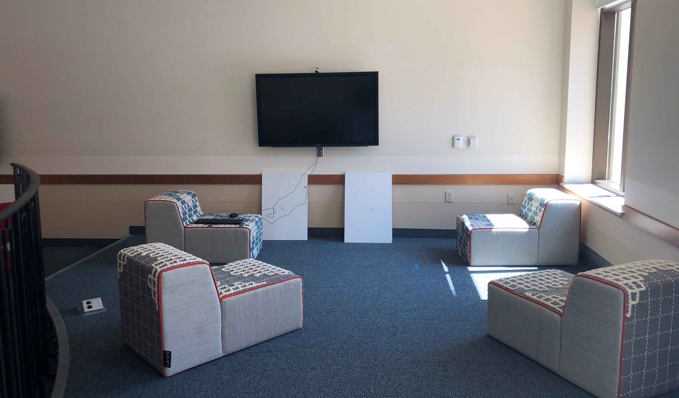
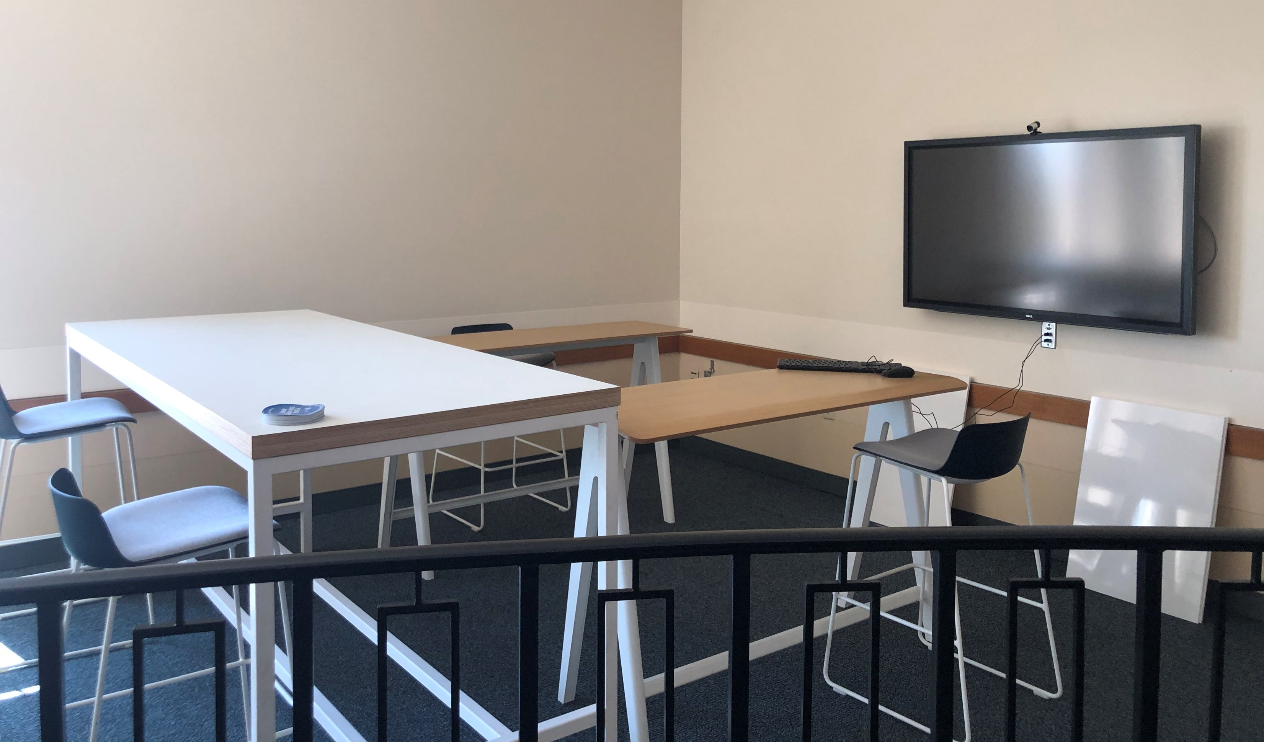
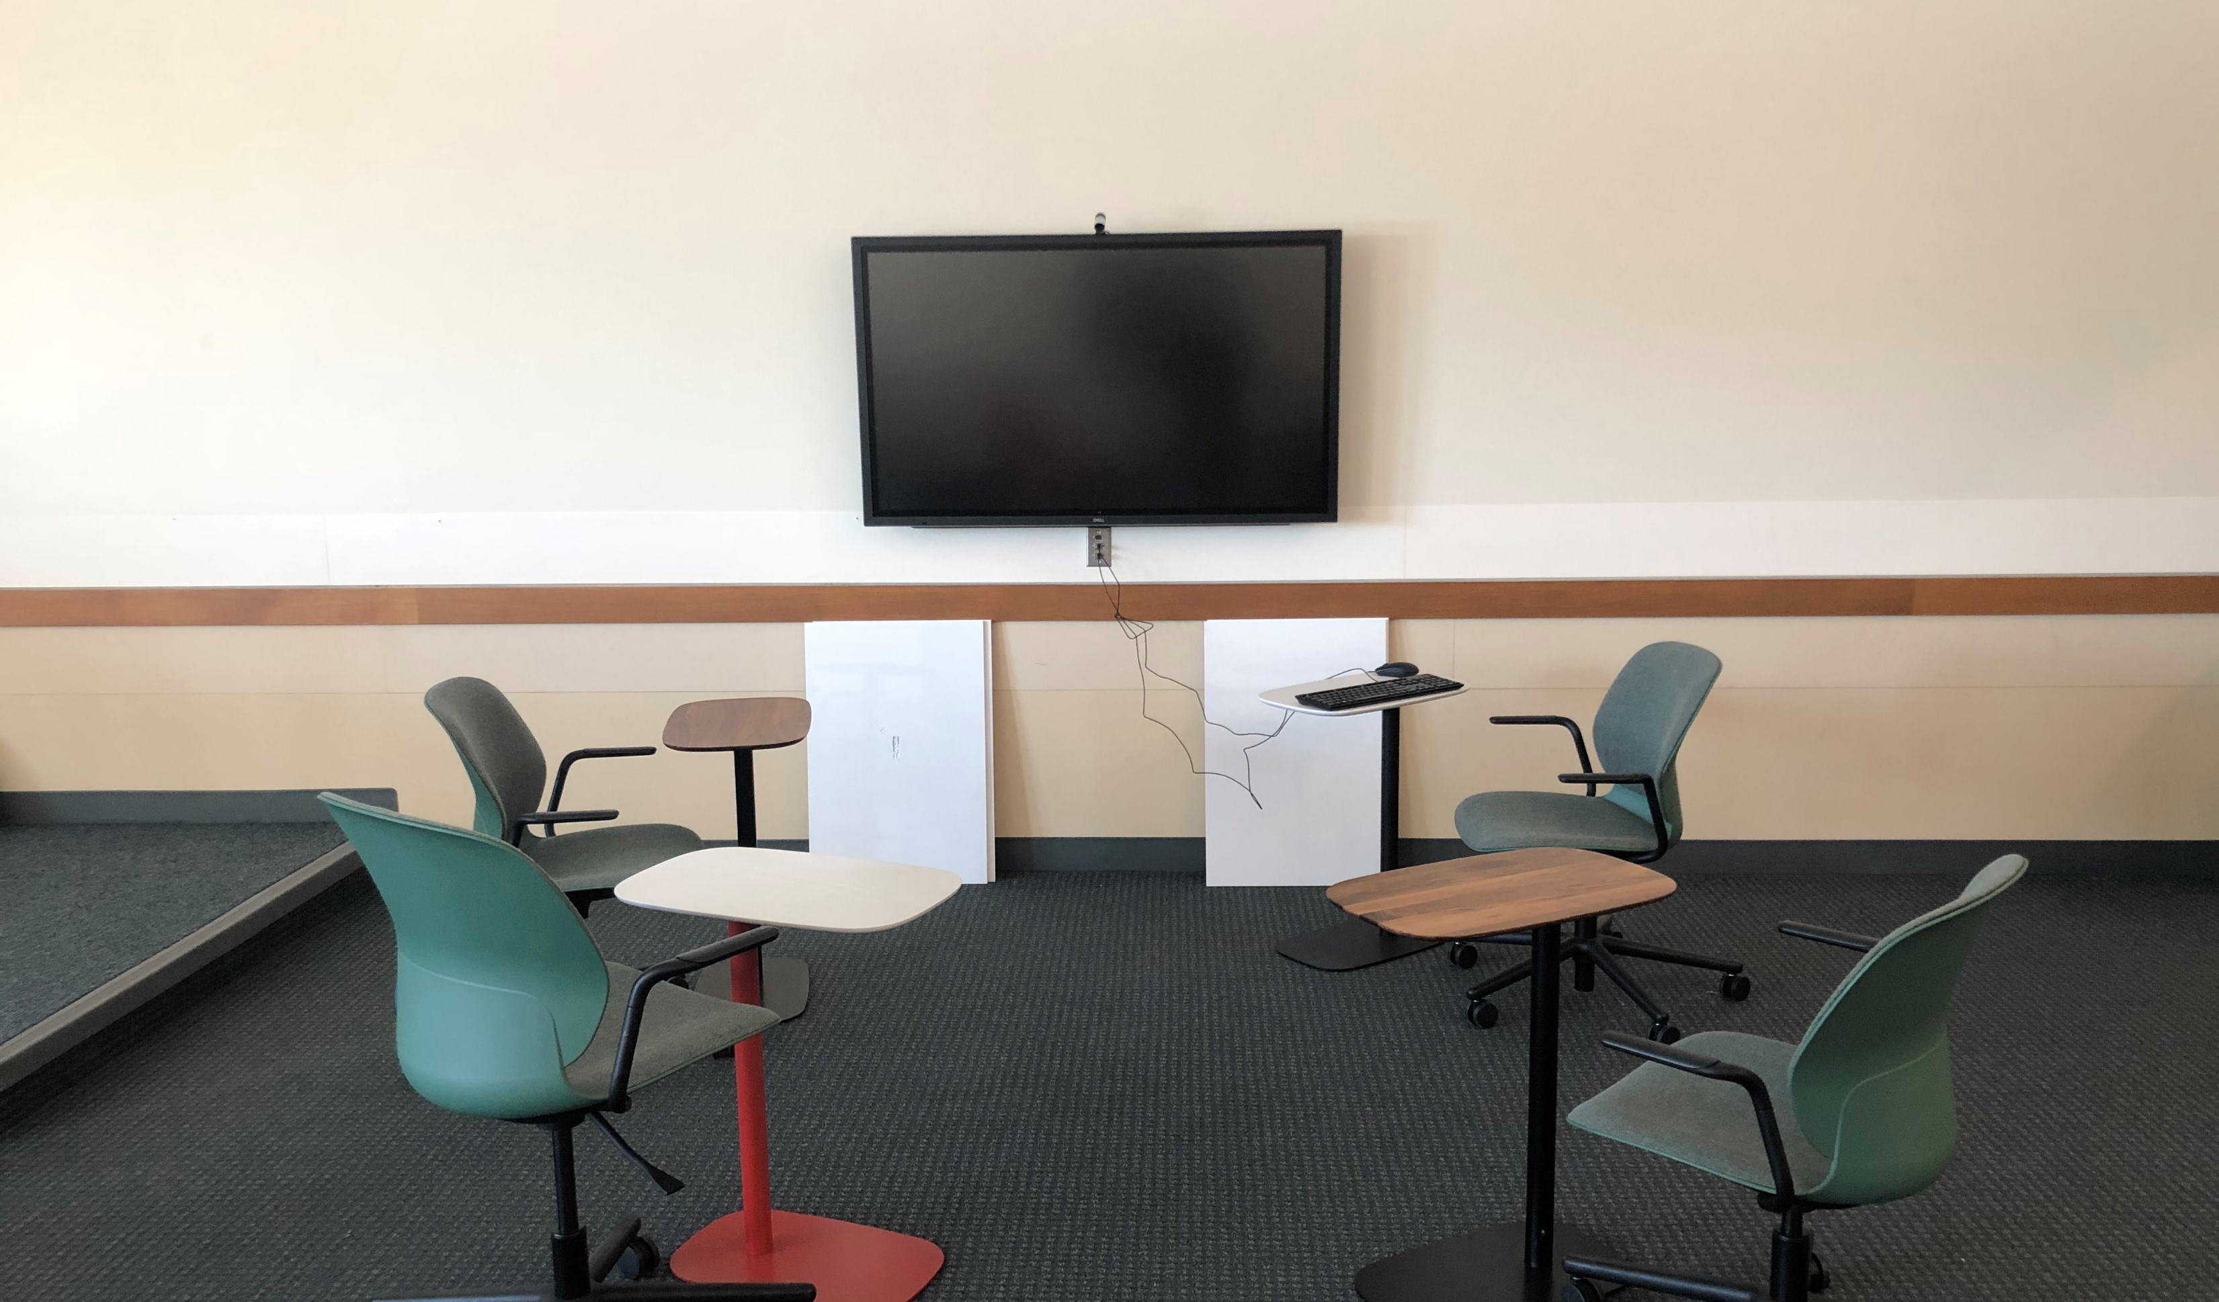
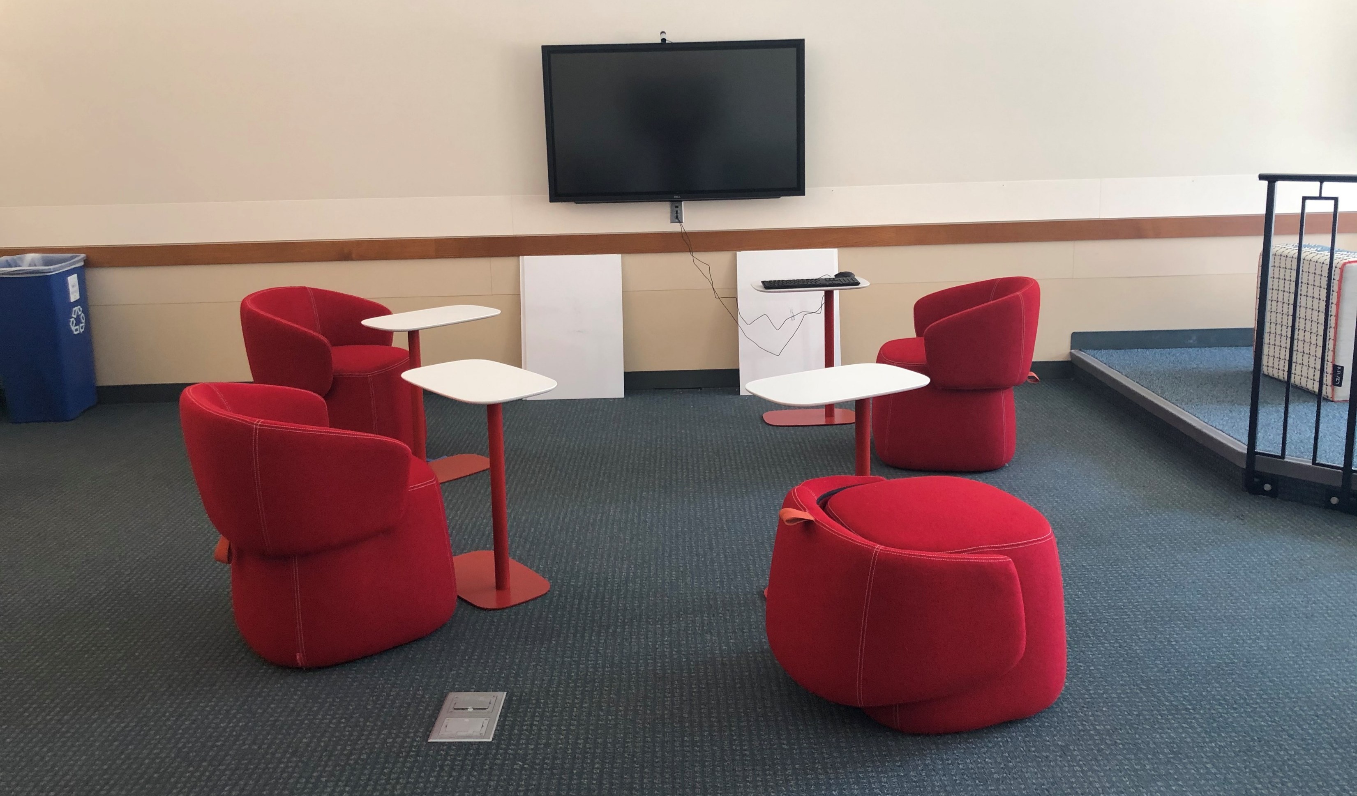
Classroom 2001 – The Haworth Room
Seats for 20 Students
5 Groups of 4
6 Bluescape Screens
Whiteboards
5 separate spaces
4 students per space
6 screens
4 whiteboards at each space

Slide 13
Student Surveys
Overview
Students were asked to what extent they agreed that each space felt supportive of
Executing Individual Tasks
Executing Team Tasks
Casual Team Conversations
Team Building
Team Problem-Solving
Team Brainstorming
Team Presentations
Team Project Discussions
Team Decision-Making
 | Pre-Semester Survey | Post-Semester Survey
Number of Questions | 60 | 85
Total Responses (n) | 58 | 20
Completion Rate | 66% | 74%
Avg. Response Time | ~5 minutes | ~5 minutes
Notes:
For the following questions, you will be shown a photo of one of the Haworth spaces within Seidman 2001. For each statement below the photo, please select the extent to which you agree or disagree with each statement about that particular Haworth space.
We sent this survey out at the beginning of the semester and at the end of the semester to appx 500 students. 10 & 5% response rate. None of the students who took the first survey also took the second, so we were unable to run statistical analyses to measure the impact of the experience on differences and would have risked measuring the wrong thing, so we stuck with descriptive statistics.
Only able to compare the “scores” for each of the spaces on each of these metrics.

Slide 14
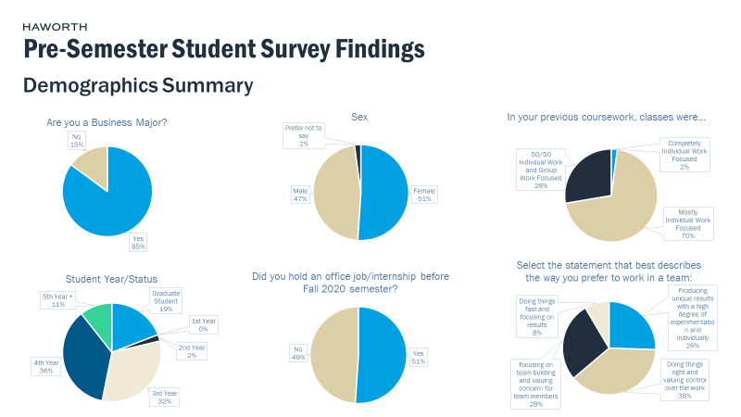
Student Surveys
Results

Slide 15
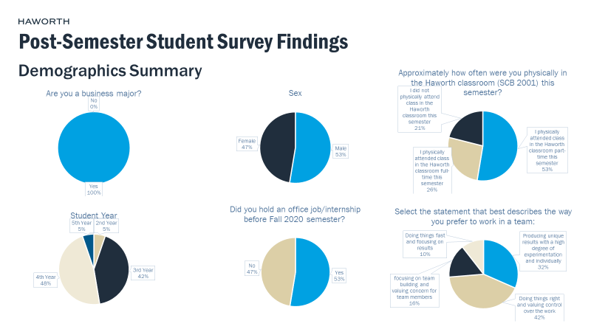
Student Surveys
Results

Slide 16
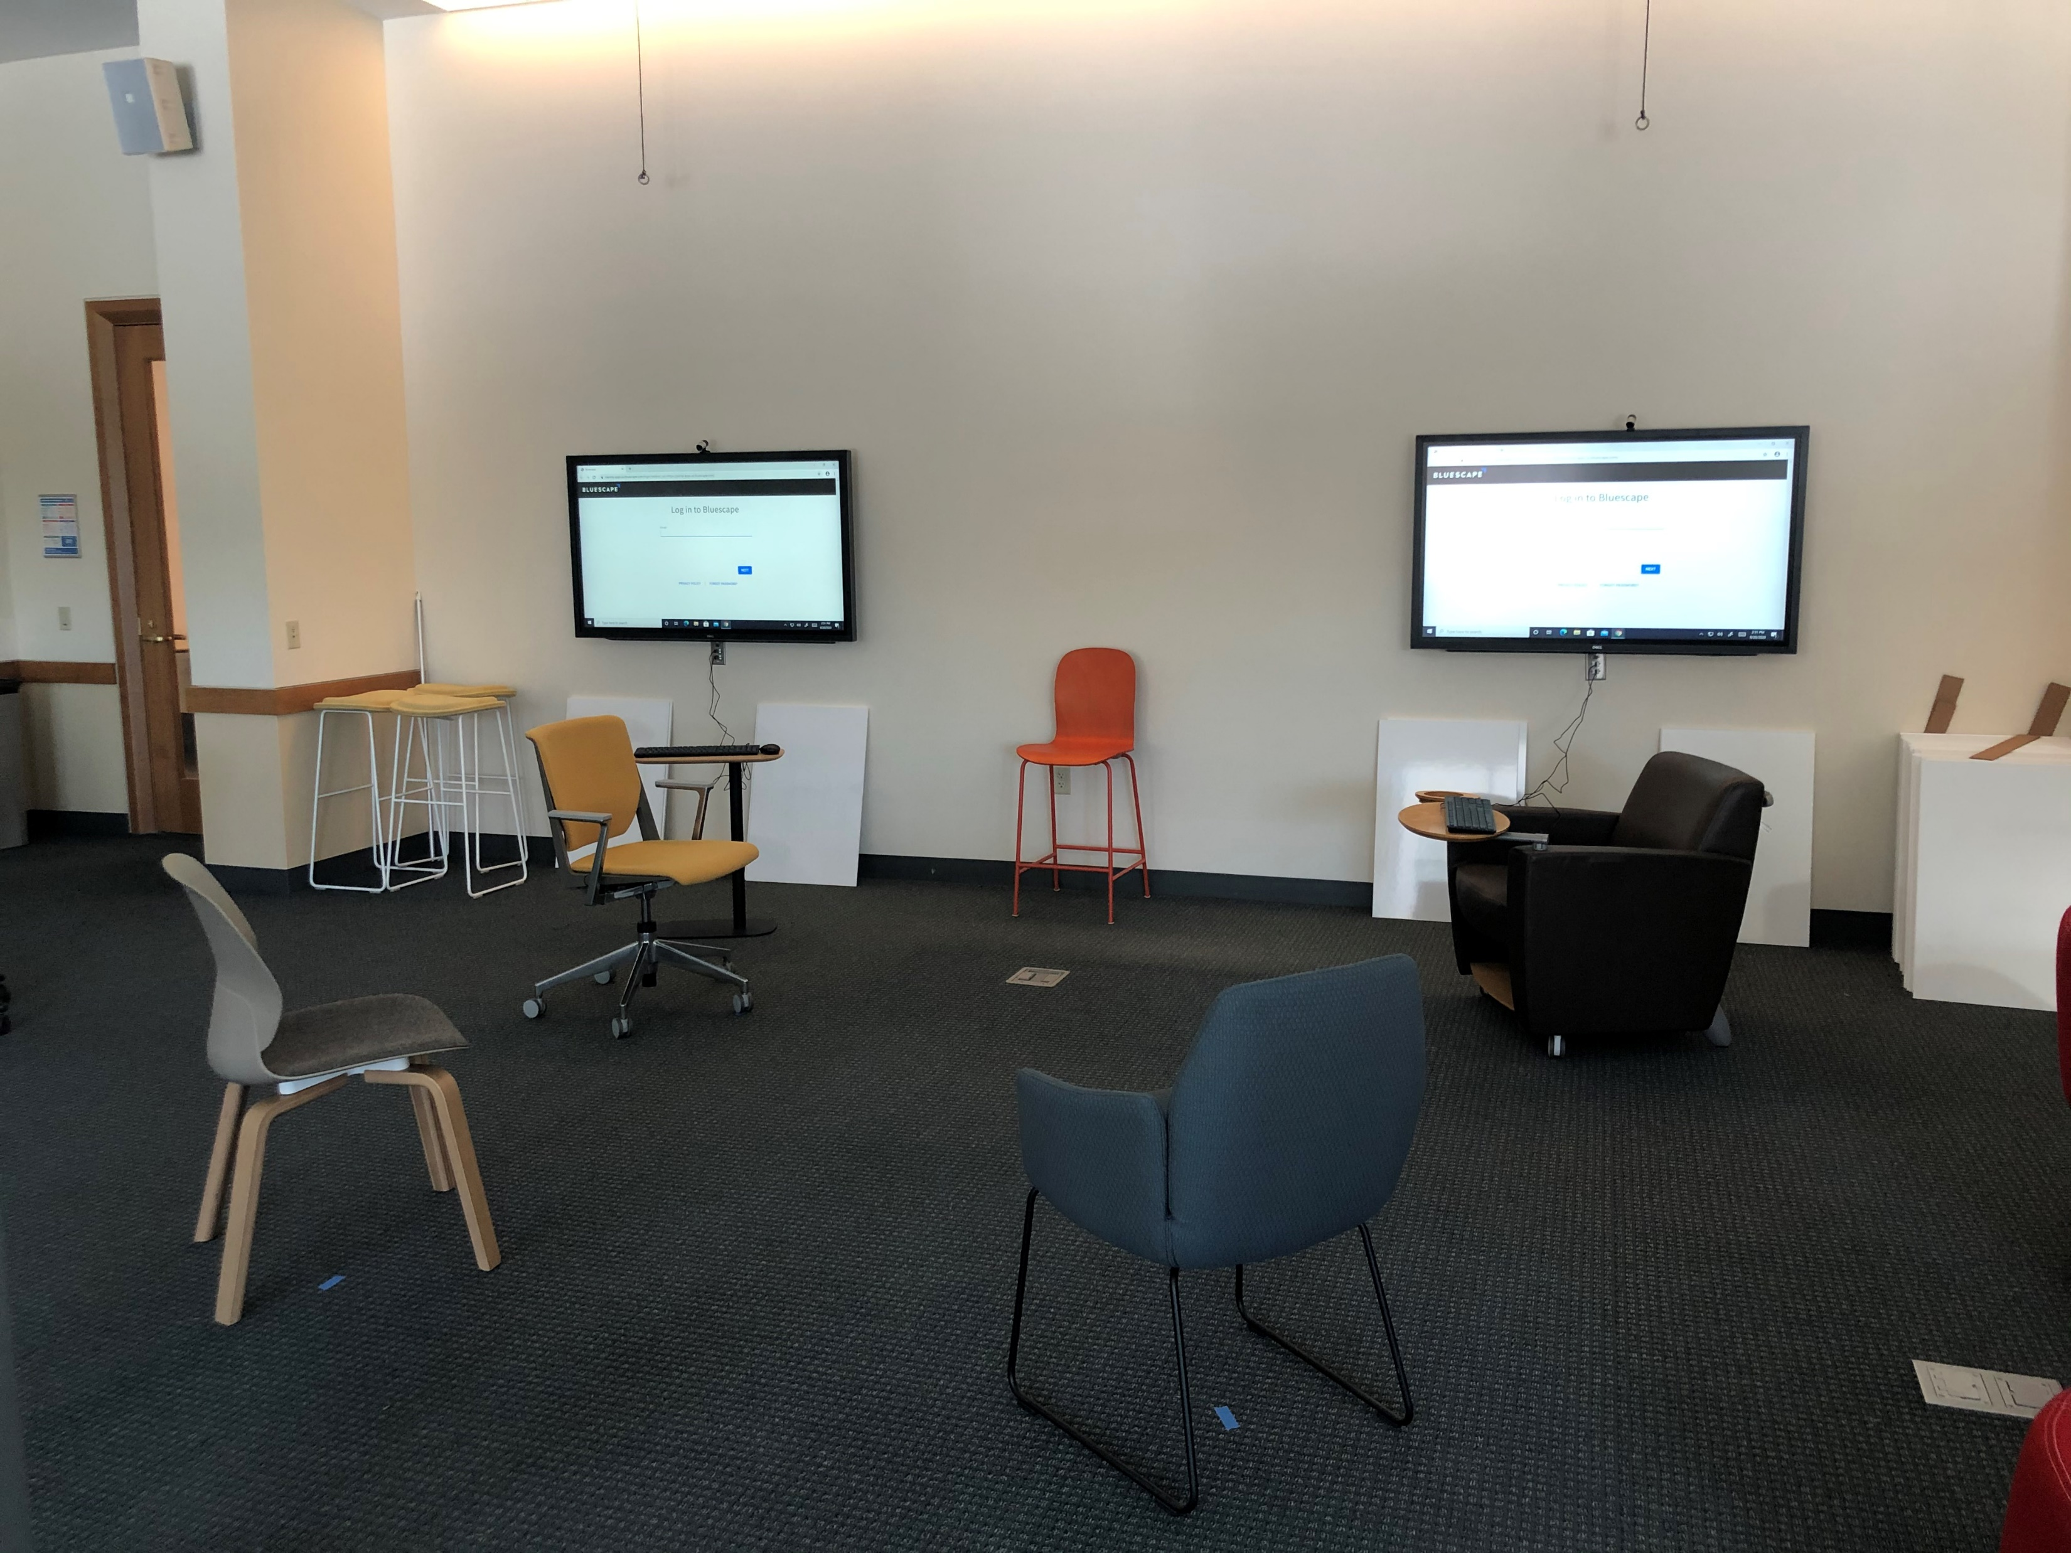
Pre & Post Student Survey Findings
PRE
Individual Tasks
Team Tasks
Casual Conversations
Team Building
Team Problem-Solving
Team Brainstorming
Presentations
Project Discussions
Team Decision Making
POST
Individual Tasks
Team Tasks
Casual Conversations
Team Building
Team Problem-Solving
Team Brainstorming
Presentations
Project Discussions
Team Decision Making
Completely Agree | Mostly Agree | Neutral | Mostly Disagree | Completely Disagree

Slide 17
Student Survey Statistical Results
Key Findings:
In the pre-survey, students on average rated Spaces B and C as most supportive overall
In the post-survey, students on average rated Space C as most supportive overall, followed by Space B and then Space A
Space D lowest rated in support overall in pre- and post-survey
Ratings improved between the pre- and post-survey in for all spaces except Space E
Space C saw the biggest difference between pre- and post-survey with an increase of .5, then Spaces B and E with increase and decrease of .333, respectively.
MEDIAN VALUES OVERALL | A PRE | A POST | B PRE | B POST | C PRE | C POST | D PRE | D POST | E PRE | E POST
Individual Tasks | 2 | 2 | 2 | 1.5 | 2 | 2 | 4 | 2 | 3 | 2.5
Team Tasks | 2 | 2 | 2 | 2 | 2 | 1.5 | 3.5 | 4 | 2 | 2.5
Casual Conversations | 2 | 2 | 2 | 1 | 2 | 1 | 2 | 2 | 2 | 2
Team Building | 2 | 2 | 2 | 1.5 | 2 | 1.5 | 2 | 2 | 2 | 2
Team Problem-Solving | 2 | 1 | 2 | 2 | 2 | 1 | 3 | 2 | 2 | 2.5
Team Brainstorming | 2 | 2 | 2 | 2 | 2 | 1 | 2 | 2 | 2 | 2
Presentations | 3 | 2 | 2 | 2 | 2 | 2 | 4 | 4 | 3 | 3.5
Project Discussions | 2 | 2 | 2 | 1 | 2 | 2 | 2 | 2 | 2 | 2
Team Decision Making | 2 | 1 | 2 | 2 | 2 | 1.5 | 3 | 2 | 2 | 2
Column Averages | 2.111111 | 1.777778 | 2 | 1.666667 | 2 | 1.666667 | 2.833333 | 2.444444 | 2.222222 | 2.333333
Post – Pre (Change) | Difference | -.333 | Difference | -.333 | Difference | -.333 | Difference | -.389 | Difference | .111
1=Completely Agree 2=Somewhat Agree 3=Neutral 4=Somewhat Disagree 5=Completely Disagree

Slide 18
Student Survey Statistical Results
Takeaways
Students generally seem to prefer spaces with Individual surfaces Castors Upright position Cohesion

Slide 19
In-Class Observations
Part III
*missing focus groups*

Slide 20
In-Class Observations
Overview
 | Class 1 | Class 2
Course Content | Marketing Course | Management Course
Course Periods | 3 hours once/week | 1.5 hours twice/week
Professor Track | Academic | Academic
Teaching Style | Interactive, Activity-Based | Interactive, Group-Work-Based
Student Teams | New teams each week | Semester-long teams
Total Classes Observed | 3 | 4
Total Hours Observed | 9 | 6

Slide 21
In-Class Observations
Notes:
Coded our observation notes into a similar general/on average positive or negative association given the following characteristics.
Did they use surfaces, did they assume an active posture (leaning forward/in indicating interest), were they comfortable for longer periods of time or did they fidget and have to move around to get comfortable, did they appear to have and/or use the mobility of the furniture, and then at the end of the classes we asked students for feedback about what spaces they liked and didn’t like.
Overall, students liked space C (green chairs) the most and the tall tables the least. It appeared from observations that students got the most support out of space C (green chairs) and least out of space D (lounge chairs) which aligns with our interview and survey findings. Interestingly, some students really loved the lounge chairs, but they were in the minority.
The spaces overall would have benefitted from more mobility, more long-term comfort, and better/bigger surfaces.

Slide 22
In-Class Observations
Space Comparisons
Used Surfaces?
Active Posture?
Long-term Comfort
Mobility
Liked/Disliked? |  |  |  | **
*
*One of the classes didn’t acknowledge this as its own space – didn’t realize it was a space
**While mostly disliked, some strong positive reactions from students here, too
Yes | Mostly Yes | Neutral | Mostly No | No
Notes:
Coded our observation notes into a similar general/on average positive or negative association given the following characteristics.
Did they use surfaces, did they assume an active posture (leaning forward/in indicating interest), were they comfortable for longer periods of time or did they fidget and have to move around to get comfortable, did they appear to have and/or use the mobility of the furniture, and then at the end of the classes we asked students for feedback about what spaces they liked and didn’t like.
Overall, students liked space C (green chairs) the most and the tall tables the least. It appeared from observations that students got the most support out of space C (green chairs) and least out of space D (lounge chairs) which aligns with our interview and survey findings. Interestingly, some students really loved the lounge chairs, but they were in the minority.
The spaces overall would have benefitted from more mobility, more long-term comfort, and better/bigger surfaces.

Slide 23
In-Class Observations
Overall Findings
Haworth Spaces appear to support group work and conversation well.
Students (and professors) are opinionated about the spaces and furniture.
Students value mobility and flexibility but didn’t seem to use it much.
Spaces seem to allow for professor “pollination” well.
Students didn’t use the tech to its fullest potential.
**Because of COVID, it’s difficult to conclude that the behaviors we observed were due to the spaces and not safety measures.
Notes:
Haworth Spaces appear to support group work and conversation well.
Task type (brainstorming, problem-solving, listening, talking, etc.) seemed to be driven more by groups themselves and the activities at hand than furniture
Students fidget and have a hard time paying attention in the lounge seating
Students (and professors) are opinionated about the spaces and furniture.
Some refuse to sit certain places, others “claim” certain spots
Students value mobility and flexibility, but didn’t seem to use it much.
Could be COVID-related, convention set in the classroom before our observations
Only would move a little to huddle in groups
Exception – Space E, students would pull seats from other spaces into Space E
Spaces seem to allow for professor “pollination” well.
Students didn’t use the tech to its fullest potential.
Students didn’t touch the BS screens to use them, worked from their own computers (COVID)

Slide 24
Key Findings
 | Part I | Part II | Part III
Unit of Analysis | Instructors | Students | Teams
Learning Goals | What pedagogies and teaching methods do professors use and how do they use classroom spaces to support them? What works well in and what is missing from traditional classroom spaces and the Haworth spaces? | How do students perceive the spaces before and after interacting with/in them? What mediates students’ perceptions of the spaces? How might these survey results help explain what students expect vs. need out of classrooms when compared to observation and focus group data? | How do student teams actually use the Haworth spaces within the classroom? What characteristics help/hinder student team interactions for different kinds of tasks? What do student teams expect/want out of their classroom tools & experiences?
Outcomes | Instructors need mobility, flexibility, and surfaces. Need flexibility to toggle between lecture and interaction. Want classrooms to be interactive and experiential. | Students in general rated spaces as more supportive after interacting in them. Students in general preferred more traditional-like spaces and tools (castors, surfaces, etc.) | Spaces WERE conducive of team activities. Need cohesion. Spaces are for student gathering. Couldn’t see as many/organic of interactions due to COVID.
Notes:
ONLY? Design for interaction? Probably not.

Slide 25
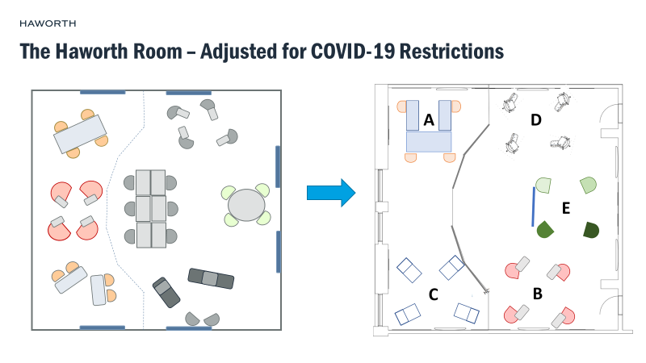
Challenges & Solutions
COVID-19
Low/Unideal Survey Participation
No Focus Groups
Students and professors had to change/limit their interactions
Solution: Work with what we could and be clear about when it was a mediating factor in our results
Less than 10% participation rate
We had hoped to run t-tests on surveys to see if students’ perceptions of the spaces were statistically different pre- and post-semester, but didn’t get the right participation for it
Solution: Lean into descriptive statistics
Even after numerous attempts to recruit, we had no volunteers for student focus groups
Solution: The study overall made us realize that students’ ideas and experiences were most important to us, so restructured the design of the next round to partner with professors and students

Slide 26
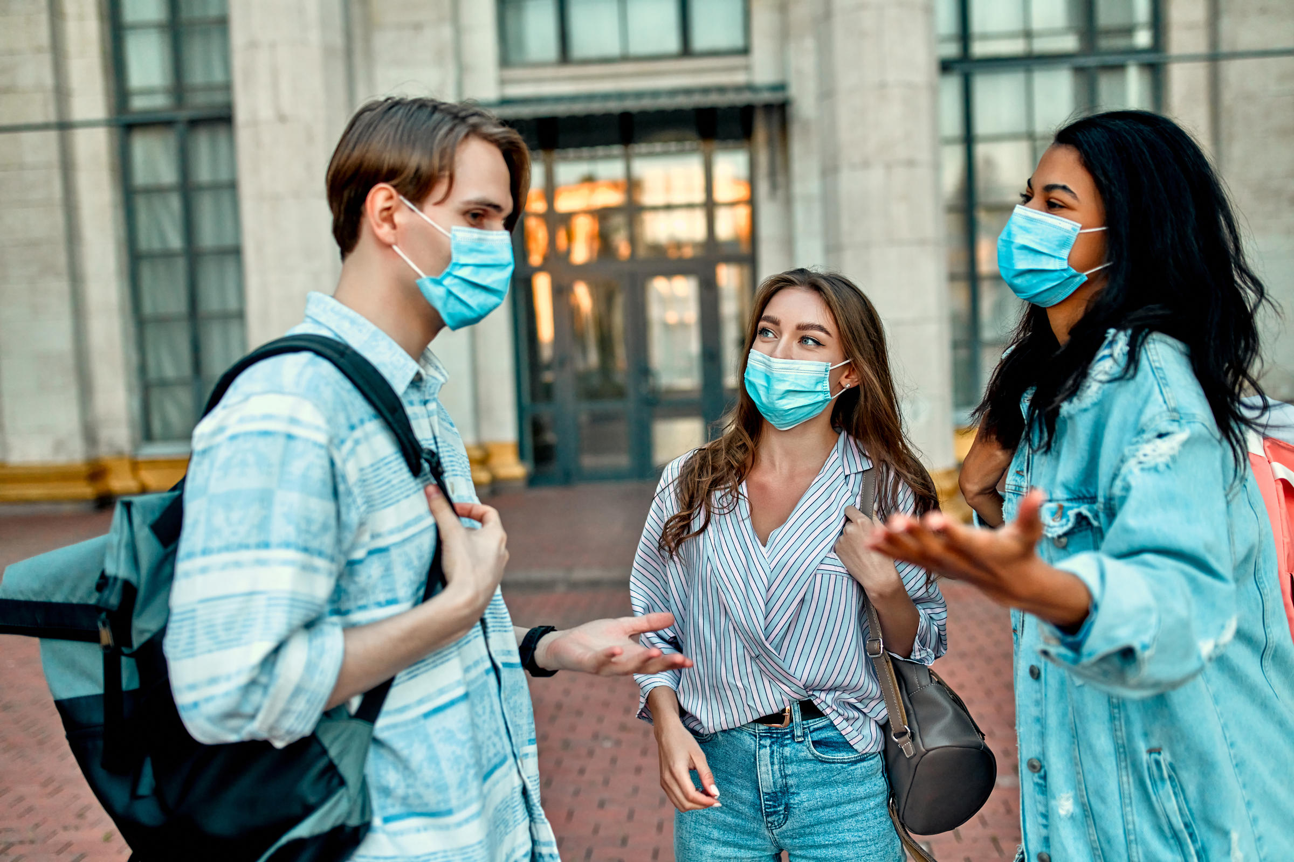
Summary
We were able to learn some, not all, of what we had hoped despite COVID-19 threatening the project altogether.
The study utilized a combination of methods to study the different aspects of the students’ and professors’ expectations and experiences within the classroom which help inform what to emphasize in the future of the classroom.
The study successfully built a partnership which has resulted in ongoing studies and commitments to sales.
Due to study challenges with participation, we redesigned the second round of the study to take a partnership approach with specific professors and build the study into class curriculums.

Slide 27
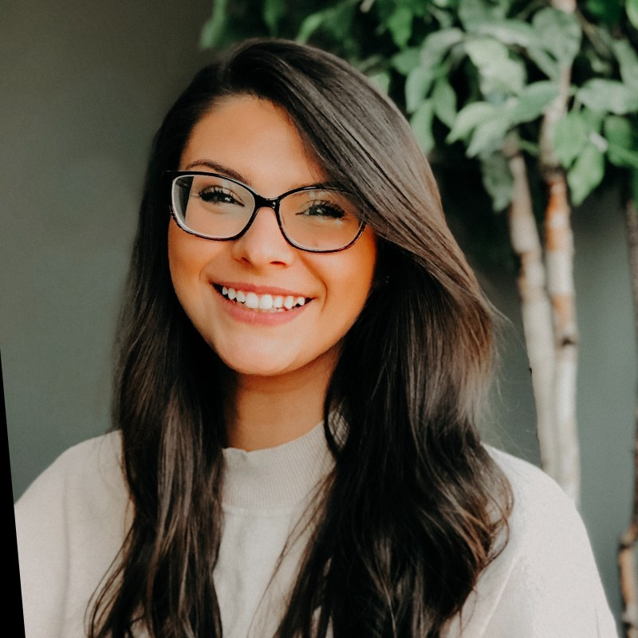
Thank you
Cassandra Skinner, M.A., M.A.
caskinner23@gmail.com
Cassandraskinner.wordpress.com

